Slide 1


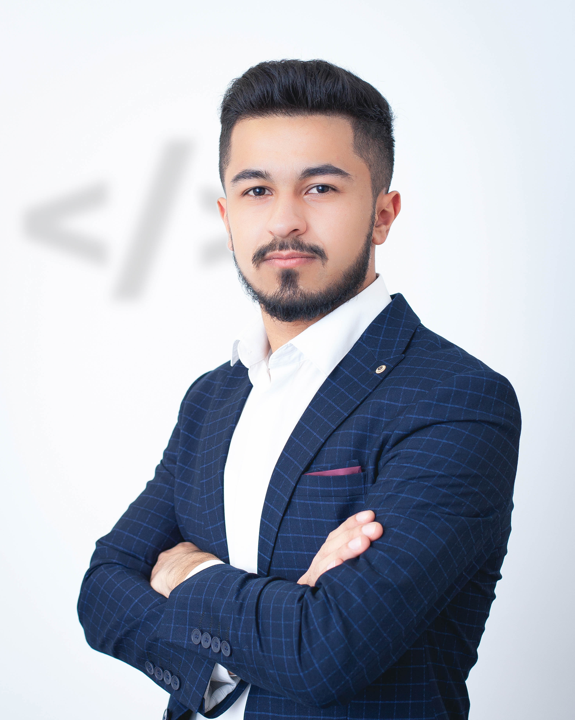
Hello!
I am Elbrus Garayev.

Slide 2






Over Brain
http://overbrain.herokuapp.com/

Slide 3



What is “Over Brain”?

Slide 4
Over Brain
Registration
Confirm email
Login
Home
Users
Chat
Profile
Logout
Ask question
Profile
Message
Follow/Unfollow
Change photo
Change Password
Answers
Questions

Slide 5


Slide 6








Used technologies
Spring Boot
Spring Security
Mail Sending
Hibernate
Thymeleaf(&Extras)
PostgreSQL
Heroku
Bootstrap
and so on.

Slide 7
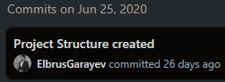

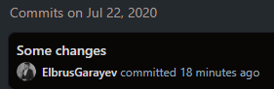
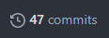
Github
https://github.com/ElbrusGarayev/over-brain

Slide 8



Frontend Part

Slide 9
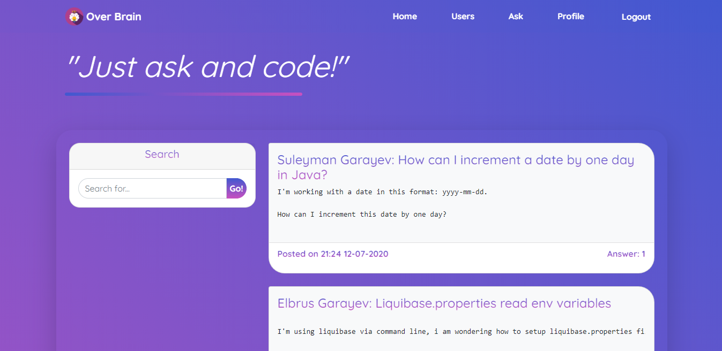
Desktop View

Slide 10
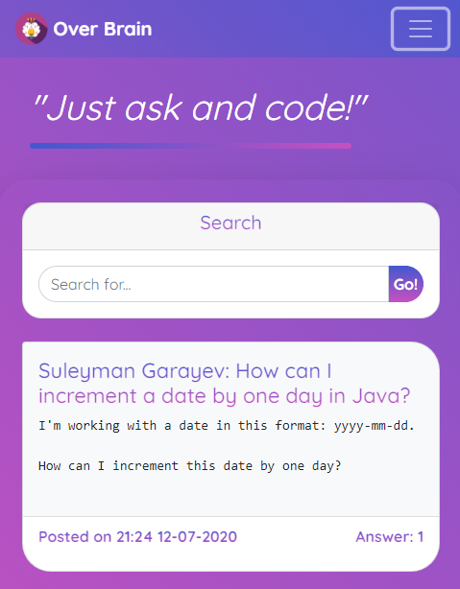
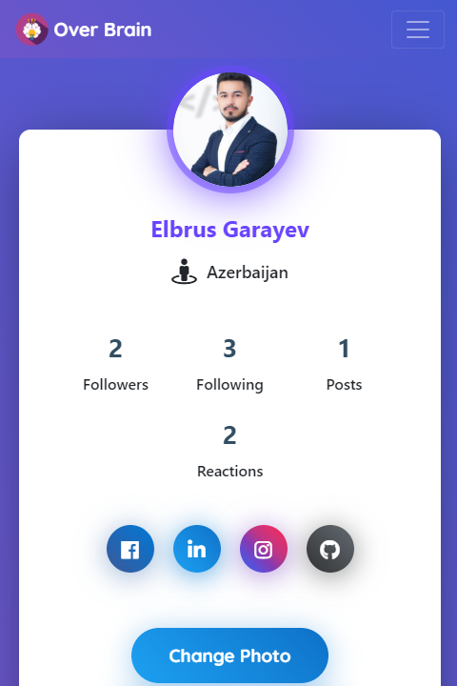
Mobile View

Slide 11
Deployed version
http://overbrain.herokuapp.com/

Slide 12

Code example

Slide 13

Thanks!
Any questions?
You can find me at:
www.linkedin.com/in/elbrus-qarayev/

